Slide 1
FACE detection Method based on YOLOV3 USING DEEP LEARNING
18CSC206J - SOFTWARE ENGINEERING AND PROJECT MANAGEMENT
BATCH - 14
CSE-A
2 - YEAR K.SURESH K.VISHAL A.AKHIL
- RA1911003020036
- RA1911003020032
- RA1911003020030
B.PRUDHVI - RA1911003020044

Slide 2
OBJECTIVE:
Face detection is a computer technology being used in a variety of applications that identiﬁes human faces in digital images. Face detection also refers to the psychological process by which humans locate and attend to faces in a visual scene.
The primary aim of face detection algorithms is to determine whether there is any face in an image or not. ... It is widely used in cameras to identify multiple appearances in the frame Ex- Mobile cameras and DSLR's. Facebook is also using face detection algorithm to detect faces in the images and recognise them.

Slide 3
Human detection is an essential task in so many applications, especially surveillance systems. Recently, ConvNets (ConvolutionalNeural Networks)-based YOLO model is a successful method applied for object (including human) detection. It is one of the fastest way to detect directly objects from the input image. However, compared to the Convets-based state-of-the-art object detection methods, YOLO model-based object detection method achieved less accuracy. In this paper, we propose a new real-time human detection under ﬁsheye cameras for surveillance purpose based on YOLO model.
However, we improve the preciseness by using 2-D input channels consisting of grey-level image channel and foreground-background context information extracted by AGMM (Adaptive Gaussian Mixture Model) instead of original 3-D color input channels for ConvNets-based YOLO model. It is shown through experiments that the proposed method performs better with respect to accuracy and processing speed degradation compared to YOLO model-based human detection so that it can be successfully employed for embedded surveillance application.

Slide 4
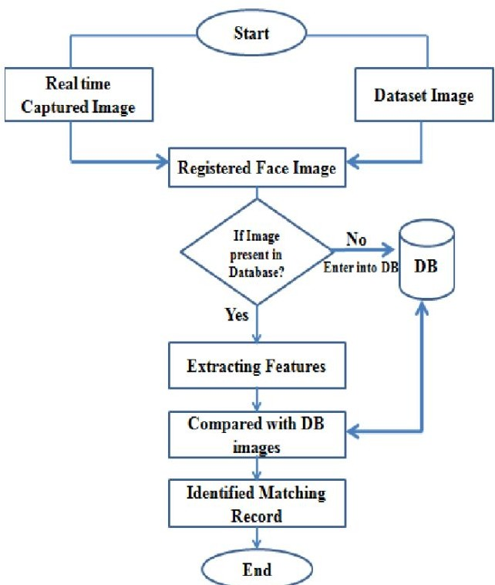
WORK FLOW DIAGRAM:

Slide 5
MODULE DESCRIPTION:
A face detection system is a technology capable of matching a human face from a digital image or a video frame against a database of faces, typically employed to authenticate users through ID veriﬁcation services, works by pinpointing and measuring facial features from a given image.
While initially a form of computer application, facial recognition systems have seen wider uses in recent times on smartphones and in other forms of technology, such as robotics. Because computerized facial recognition involves the measurement of a human's physiological characteristics facial recognition systems are categorised as biometrics. Although the accuracy of facial recognition systems as a biometric technology is lower than iris recognition and ﬁngerprint recognition, it is widely adopted due to its contactless process.[1] Facial recognition systems have been deployed in advanced
human-computer interaction, video surveillance and automatic indexing of images.[2] They are also used widely by law enforcement agencies.

Slide 6
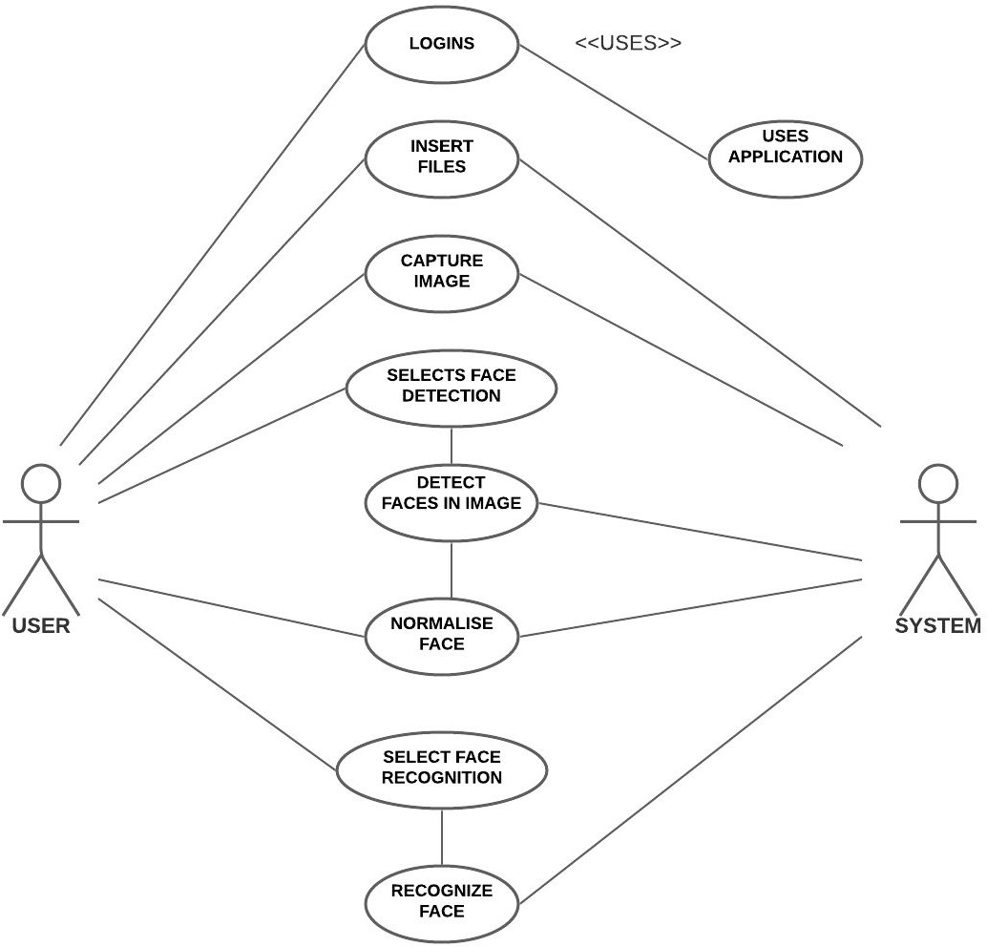
UML DIAGRAMS
USE CASE DIAGRAM :

Slide 7
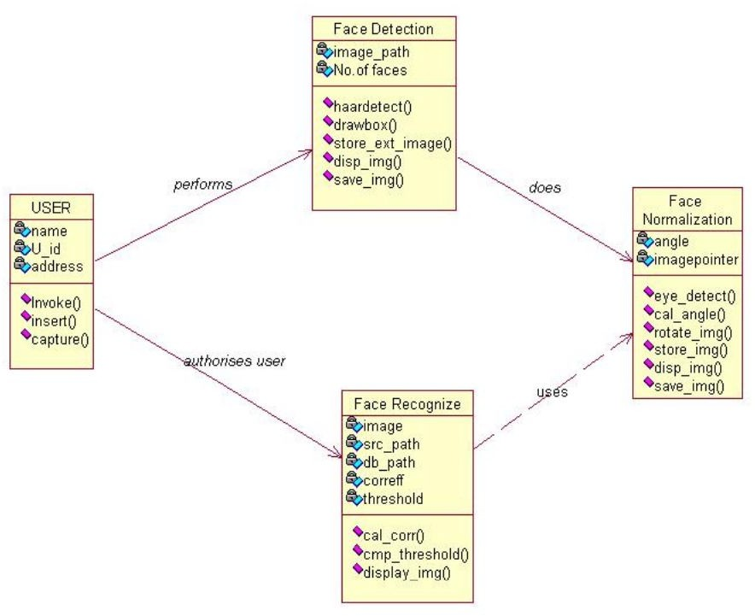
CLASS DIAGRAM:

Slide 8
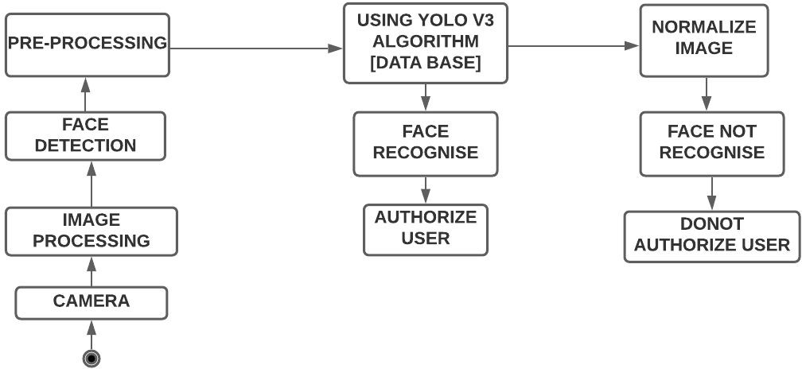
ACTIVITY DIAGRAM :

Slide 9
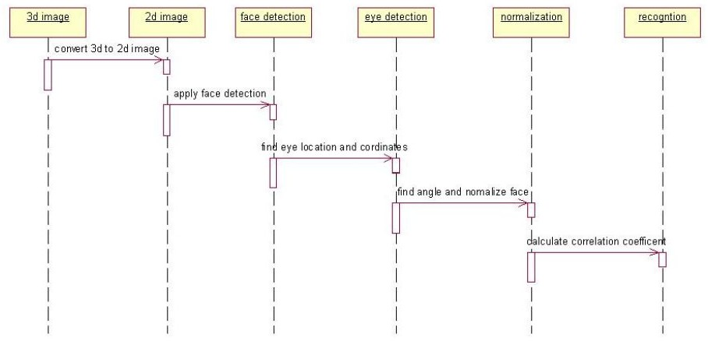
SEQUENCE DIAGRAM:

Slide 10
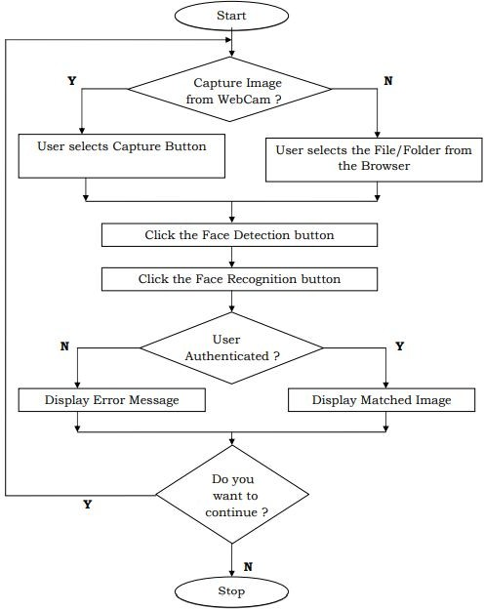
FLOW CHART :

Slide 11
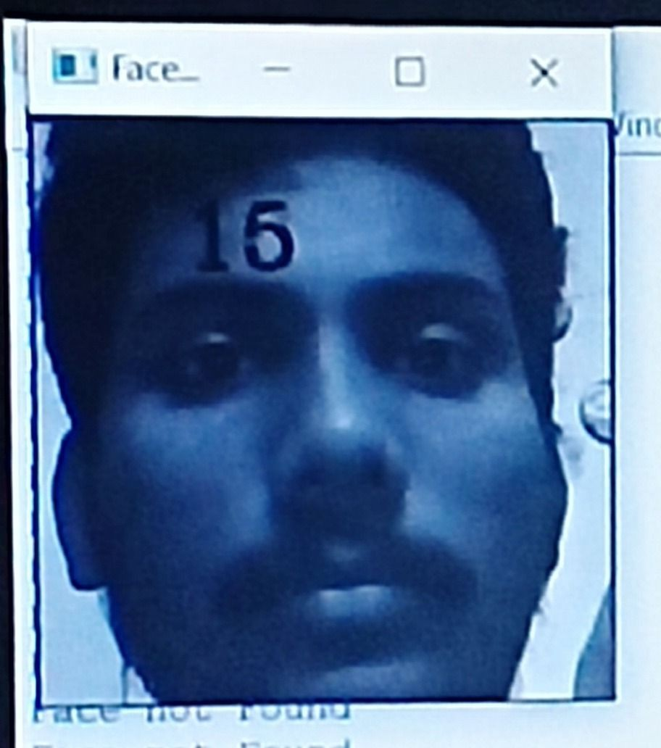
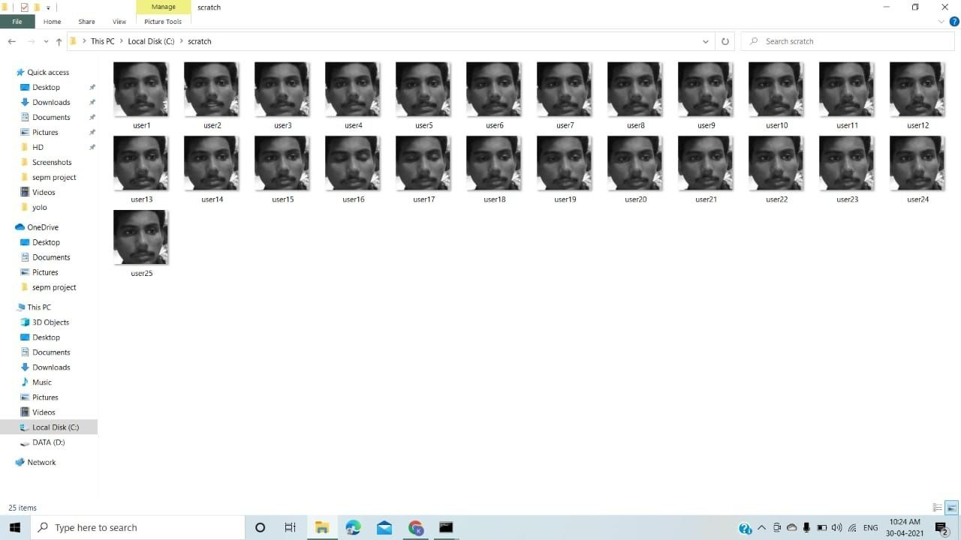
SCREENSHOTS OR DEMO

Slide 12
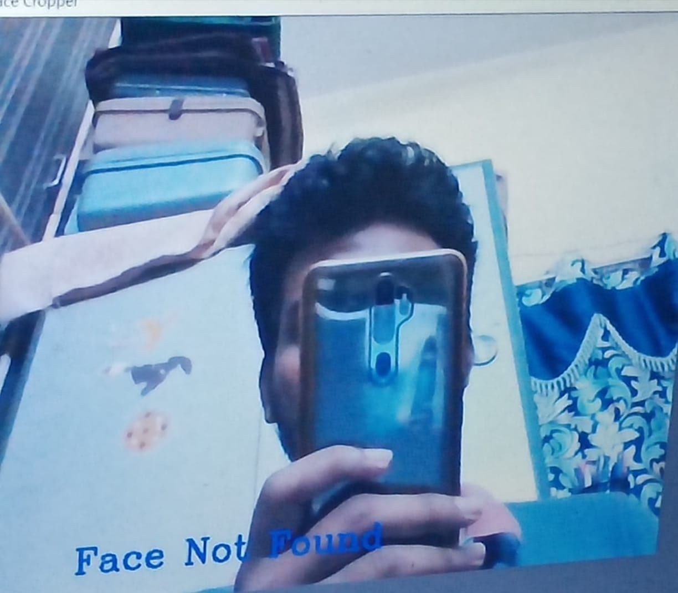
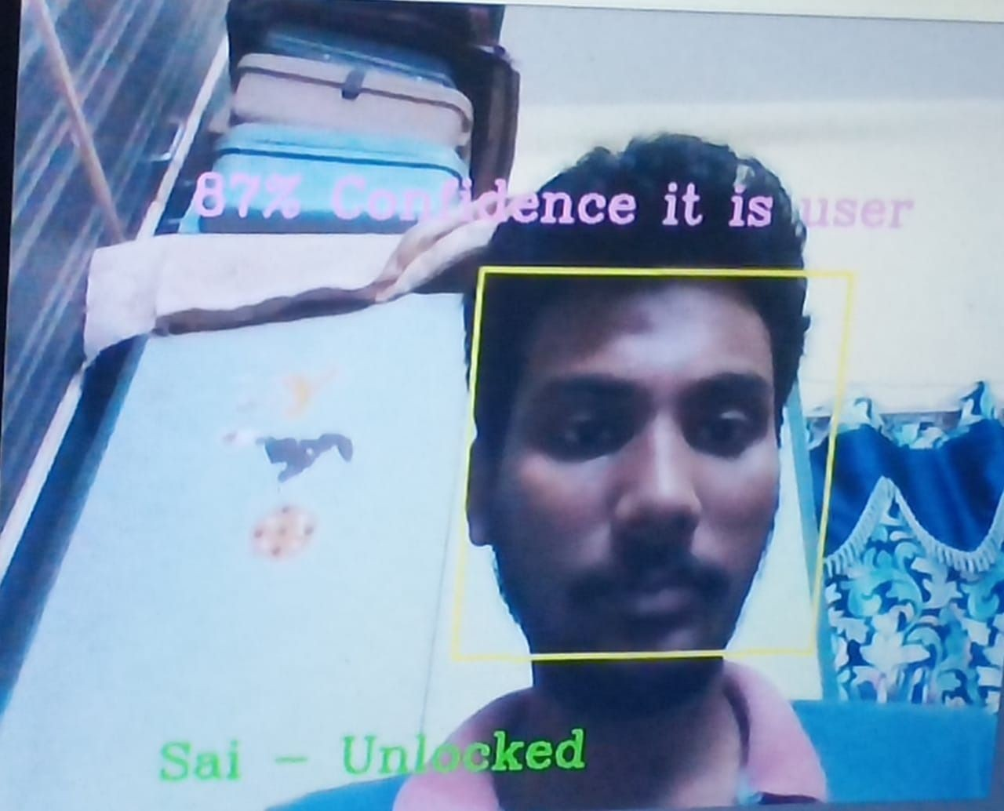

Slide 13
THE FINAL OUTPUT :

Slide 14
CONCLUSION
This application can be used in Network (LAN or Internet) where a user can upload an image ﬁle to our system which will be running at server end and then it will perform intended function and will return result to client who had inserted image to the application.
This application can be used in Laptops or PC’s by using Webcam for user authentication as an secondary part if user doesn’t want to enter password.
YOLO v1
YoLO v2 vs YoLO v1
Speed (45 frames per second — better than realtime) Network understands generalized object representation

Slide 15
This allowed them to train the network on real world images and
predictions on artwork was still fairly accurate).
faster version (with smaller architecture) — 155 frames per sec but is less accurate. In YOLO V3 we are trying to improve the accuracy
We are making the smaller version of YOLO V3 with but less accurate Compared to the main version of YOLO V3

Slide 16
REFERENCES
Wechsler H, Phillips JP, Bruce V, Soulie FF, Huang TS (eds) (1998) Face recognition: from theory to applications[M]. Springer, New York
Buenaposada JM, Muñoz E, Baumela L (2008) Recognising facial expressions in video sequences. Pattern Anal Appl 11(1):101–116
Nguyen D, Halupka D, Aarabi P et al (2006) Real-time face detection and lip feature extraction using ﬁeld-programmable gate arrays. Syst Man Cybern Part B 36(4):902–912
Kim TK, Lee SU, Lee JH, et al. (2002) Integrated approach of multiple face detection for video surveillance[C]//pattern recognition, 2002. Proceedings of 16th international conference on IEEE, 2:394–397
Hjelmås E, Low BK (2001) Face detection: a survey. Comput Vis Image Underst 83(3):236–274
Yang MH, Kriegman D, Ahuja N (2002) Detecting faces in images: a survey. Pattern Anal Mach Intell IEEE Trans

